Slide 1
Hierarchical structure in financial markets
R.N. Mantegna
경상국립대학교 수학과 석사과정 오서영

Slide 2
The paradigm of mathematical finance
The time series of stock returns are unpredictable. (Samuelson, 2016)
-> Random processes
Key point
If the random processes of stock returns time series of different stocks are uncorrelated.
If economic factors are present in financial markets and are driving several stocks at the same time.

Slide 3
Modeling of financial markets
Modeling of financial markets
need to quantify a distance between different stocks traded in a financial markets.
- Hierarchical arrangement of the stocks of a given portfolio is the synchronous correlation coefficient of the daily difference of logarithm of closure price of stocks.
-> The correlation coefficient is computed between all the possible pairs of stocks present in the portfolio in a given time period.
→ The goal of the present study is to obtain the taxonomy of a portfolio of stocks traded in a financial market by using the information of time series of stock prices only.
Dataset
Dow Jones Industrial Average (DJIA) index and the portfolio of stocks used to compute the Standard and Poor’s 500 (S&P 500) index in the time period from July 1989 to October 1995. Both indices describe the performance of the New York Stock Exchange.

Slide 4
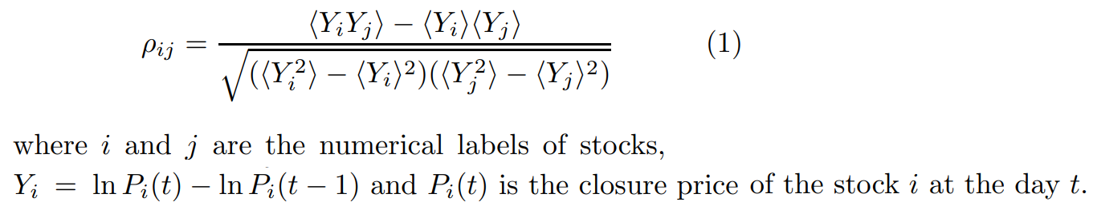

Modeling of financial markets
Quantify the degree of similarity between the synchronous time evolution of a pair of stock price by the correlation coefficient:
n × n matrix of correlation coefficients for daily logarithm price differences
The statistical average <…> is a temporal average performed on all the trading days of the investigated time period
$${−1≤ρ}_{ij}≤1$$
$$ρ_{ij}=0$$
Completely anti-correlated pair of stocks
Completely correlated pair of stocks
Two stocks are uncorrelated

Slide 5
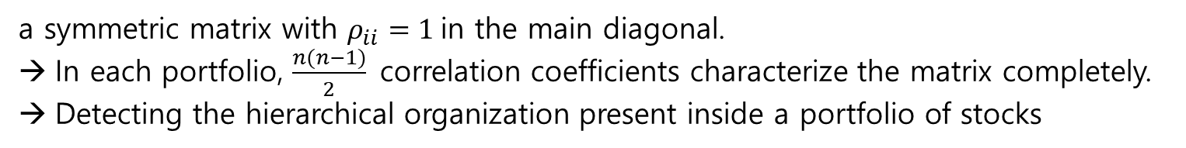
Modeling of financial markets
The correlation coefficient:
a symmetric matrix with $ρ_{ii}=1$in the main diagonal.
In each portfolio, $\frac{n(n−1)}{2}$correlation coefficients characterize the matrix completely.
Detecting the hierarchical organization present inside a portfolio of stocks

Slide 6


Modeling of financial markets
The correlation coefficient of a pair of stocks cannot be used as a distance between the two stocks.
-> Because it does not fulfill the three axioms that define a metric.
However a metric can be defined using as distance a function of the correlation coefficient.
An appropriate function:
$d(i, j) = 0 if and only if i = j$
$d(i, j) = d(j, i)$
$d(i, j) ≤ d(i, k) + d(k, j)$
$d(i, j) = 0 if and only if$ the correlation is total ($ρ=1,$namely only if the two stocks perform the same stochastic process)
The correlation coefficient matrix and the distance matrix D is symmetric
(2) is equivalent to the Euclidean distance between $\tilde{Y_{i}}$ and $\tilde{Y_{j}}$ which are obtained from the time series $Y_{i}$ and $Y_{j}$ by considering each record of the time series.
(The vector obtained must have a unitary norm,
namely it is obtained by subtracting to each record the
average value and by normalizing it to its standard
deviation.)

Slide 7
Minimal spanning tree (MST)
Calculate the correlation coefficient matrix and distance coefficient matrix between nodes on the graph
select the most important correlation
build a graph that completely connects these nodes with the shortest distance
identify the clusters of nodes
Step 1 Select an arbitrary point and connect it to the least dissimilar neighbour. These two points constitute a subgraph of the MST.
Step 2 Connect the current subgraph to the least dissimilar neighbour of any of the members of the subgraph.
Step 3 Loop on Step 2, until all points are in the one subgraph: this, then, is the MST

Slide 8
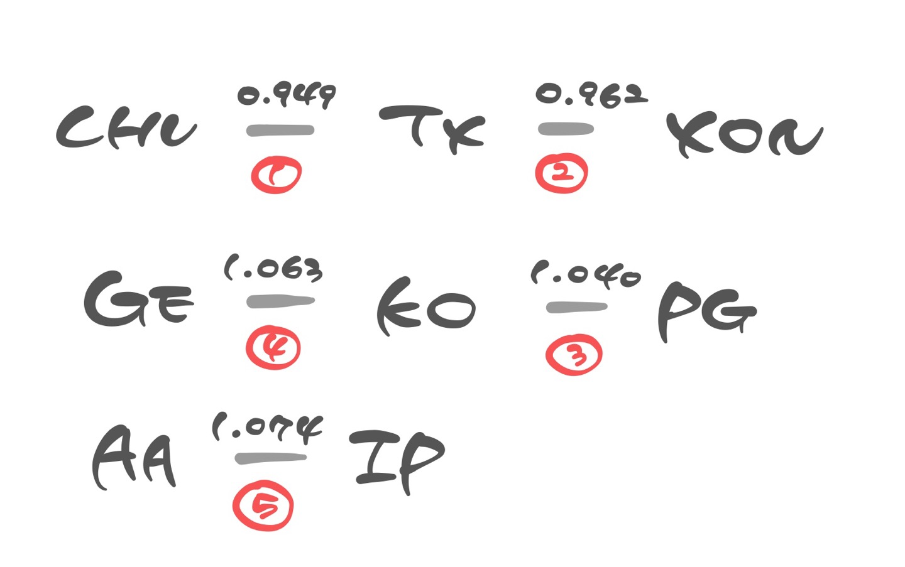
The MST associated with an Euclidean distance matrix
Order the nondiagonal elements of the distance matrix D in increasing order.
Shortest 10 distances:
CHV–TX d = 0.949 | TX–XON d = 0.962 |
CHV–XON d = 0.982 | KO–PG d = 1.040 | GE– KO d = 1.063 |
AA–IP d = 1.074 | GE–MMM d = 1.078 | KO–MCD d = 1.084 |
GE–T d = 1.090 | DD–GE d = 1.095.
-> The MST is progressively built up by linking all the elements of the set together in a graph characterized by a minimal distance between stocks.
(MMM,MCD, T and DD) need to be linked to the GE–KO–PG. MMM, T and DD → GE (which has at this stage 4 links)
MCD → KO (which has at this stage 3 links)
Three distinct groups
Different groups (IP-MMM d=1.110) is detected
→ the two groups containing MMM and IP are then linked together through the MMM-IP connection

Slide 9
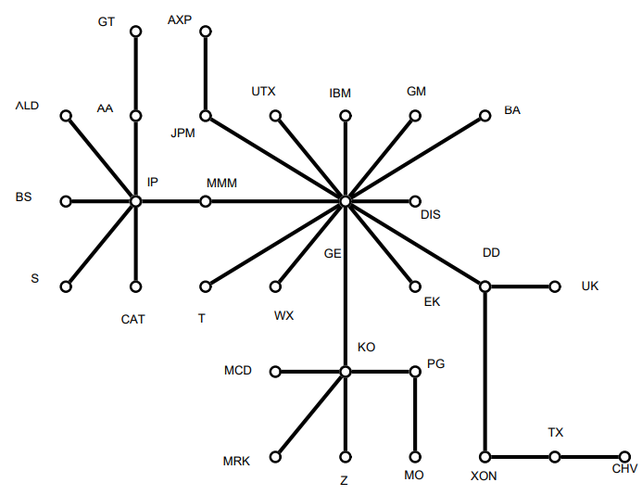
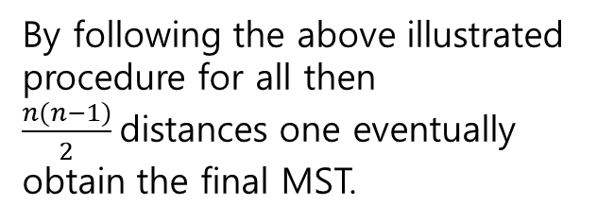
The MST associated with an Euclidean distance matrix
By following the above illustrated procedure for all then $\frac{n(n−1)}{2}$distances one eventually obtain the final MST.
Minimal spanning tree connecting the 30 stocks (DJIA)

Slide 10
The MST associated with an Euclidean distance matrix
Identifying the market's network with a Euclidean distance defined as a function of the correlation coefficient is too complex to extract useful information about the correlation coefficient between nodes.
→ The concept of ultrametric space is introduced. Among them, subdominant hyperspace is widely accepted as suitable for reasons of simplicity. (Onnela et al., 2003)
The complex interrelationship between assets measured by the Euclidean distance.
Correlation Structure Information between Assets in Ultrametric Space
greatly reduce (simplify complexity)

Slide 11
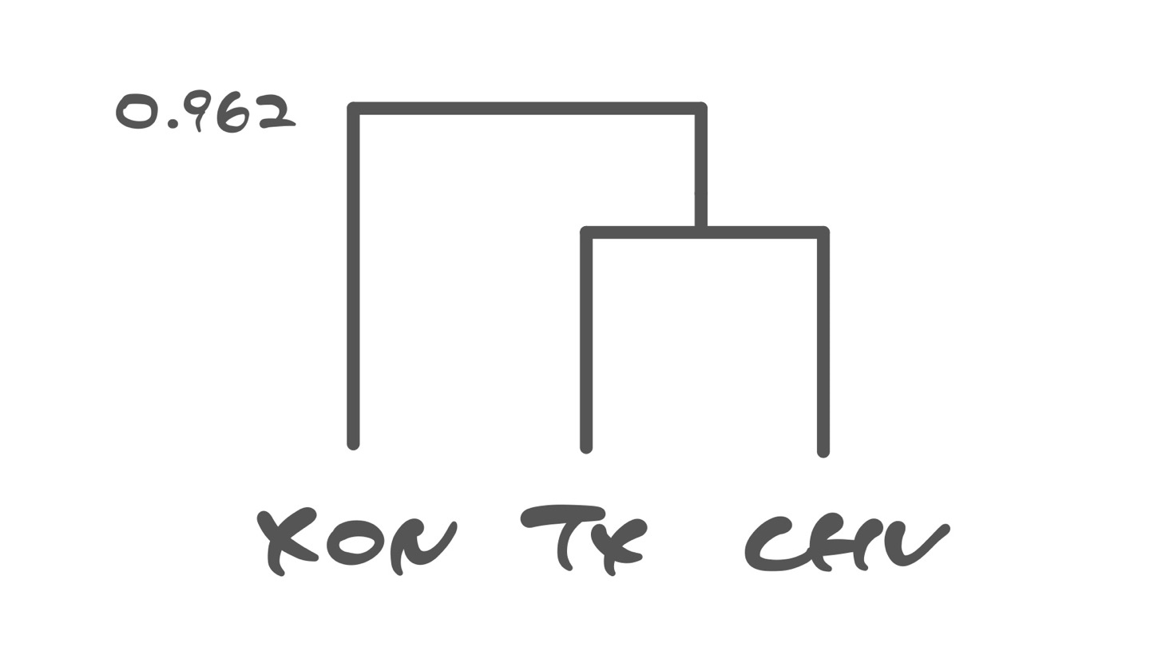

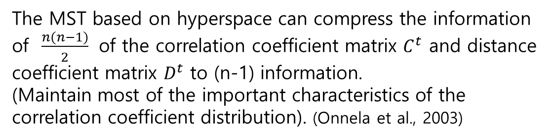
The MST associated with a subdominant ultrametric distance matrix
Subdominant ultrametric distance matrix $D^{<}$ obtained by defining the subdominant ultrametric distance $d^{<}(i,j)$ between i and j as the maximum value of any Euclidean distance $d(k,l)$ detected by moving in single steps from i to j through the shortest path connecting i and j in the MST.
Ultrametric distance between XON and CHV is $d^{<}$= 0.962
(Euclidean distance between XON and CHV is d = 0.982)
Euclidean
The MST based on hyperspace can compress the information of $\frac{n(n−1)}{2}$ of the correlation coefficient matrix $C^{t}$ and distance coefficient matrix $D^{t}$ to (n-1) information.
(Maintain most of the important characteristics of the correlation coefficient distribution). (Onnela et al., 2003)
Ultrametric
Notes:
MST에서 i와 j를 연결하는 최단 경로를 통해 i에서 j까지 단일 단계로 이동함으로써 검출된 유클리드 거리 γ(γ,γ)의 최대값으로
same ultrametric distance from TX and CHV / XON and CHV

Slide 12
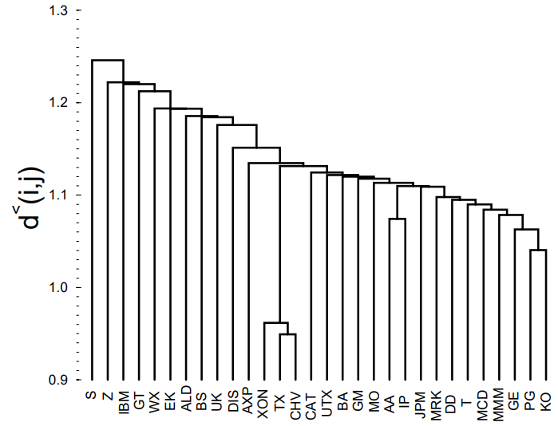
The MST associated with a subdominant ultrametric distance matrix
DJIA
Existence of three groups of stocks
direct economic explanation
1. CHV, TX and XON
are working in the same industry (energy)
2. AA and IP provide
raw materials.
3. PG and KO deal with
consumer nondurables.
Hierarchical tree of the subdominant ultrametric space associated with the MST
Notes:
MST에서 i와 j를 연결하는 최단 경로를 통해 i에서 j까지 단일 단계로 이동함으로써 검출된 유클리드 거리 γ(γ,γ)의 최대값으로
same ultrametric distance from TX and CHV / XON and CHV

Slide 13

The MST associated with a subdominant ultrametric distance matrix
The detection of a hierarchical structure in a broad portfolio of stocks traded in a financial market is consistent with the assumption that the time series of returns of a stock is affected by a number of economic factors.
The number and the relative influence of these factors is specific to each stock.
In general, stocks or groups of stocks departing early from the tree (at high values of the distance $d^{<}(i,j))$ are mainly controlled by economic factors which are specific to the considered group
When departure occurs for (moderately) low values of $d^{<}$, the stocks are affected either by economic factors which are common to all stocks and by other economic factors which are specific to the considered set of stocks. The relative relevance of these factors is quantified by the length of the segment (or segments) observed for each group from one branching to the successive one.
Notes:
금융 시장에서 거래되는 주식의 광범위한 포트폴리오에서 계층적 구조를 검출하는 것은, 주식의 수익률의 시계열이 다수의 경제적 요인에 의해 영향을 받는다는 가정과 일치한다.
이 분석은 이러한 요인의 수와 상대적인 영향력이 각 주식에 특정한다는 것을 보여준다

Slide 14
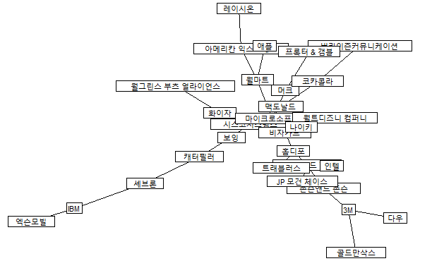
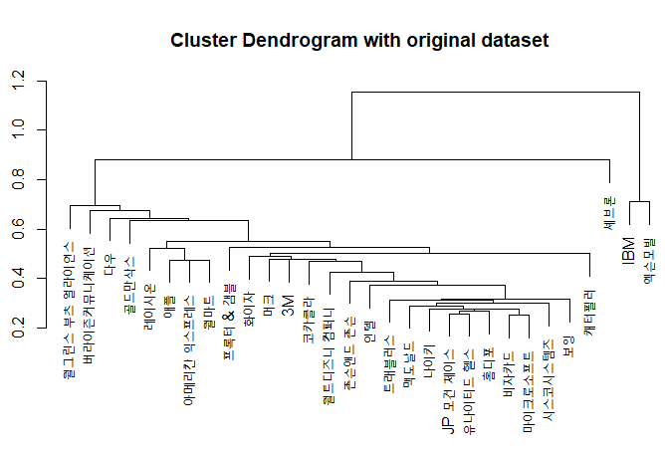
Experiments
1. Original dataset
Notes:
MST에서 i와 j를 연결하는 최단 경로를 통해 i에서 j까지 단일 단계로 이동함으로써 검출된 유클리드 거리 γ(γ,γ)의 최대값으로
same ultrametric distance from TX and CHV / XON and CHV

Slide 15
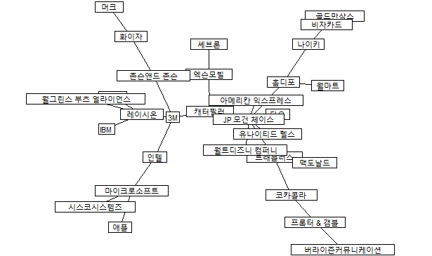
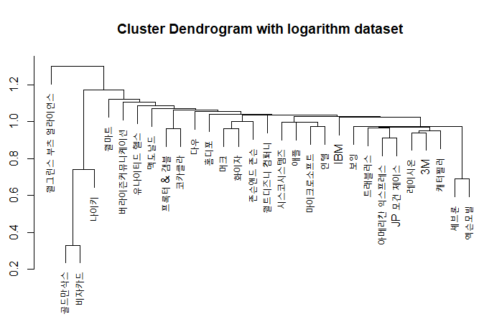
Experiments
2. Logarithm dataset $(Y=ln(P\left(t\right))−ln\left(P\left(t−1\right)\right))$
Notes:
MST에서 i와 j를 연결하는 최단 경로를 통해 i에서 j까지 단일 단계로 이동함으로써 검출된 유클리드 거리 γ(γ,γ)의 최대값으로
same ultrametric distance from TX and CHV / XON and CHV

Slide 16
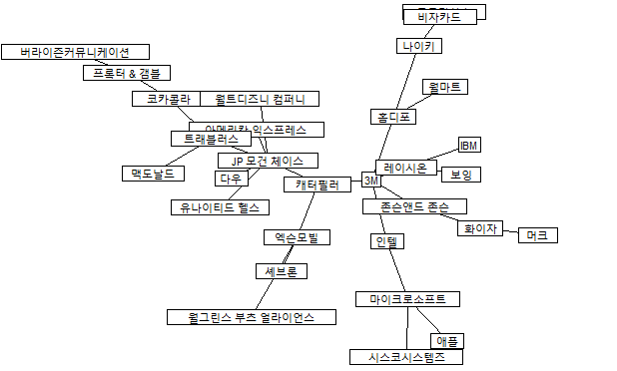
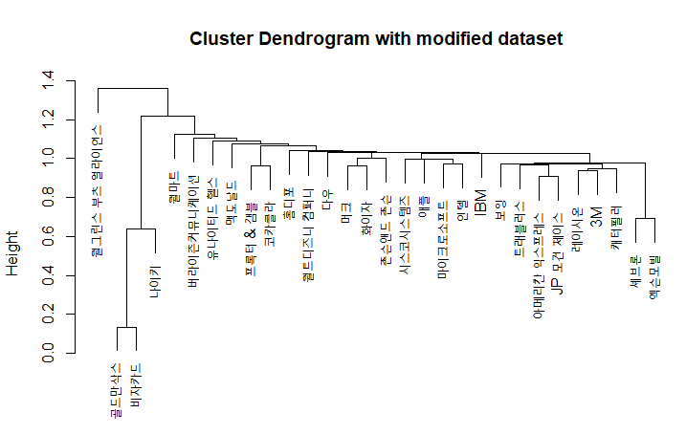
Experiments
3. Rate of change dataset $(Y=\frac{P\left(t\right)−P\left(t−1\right)}{P\left(t−1\right)})$
Notes:
MST에서 i와 j를 연결하는 최단 경로를 통해 i에서 j까지 단일 단계로 이동함으로써 검출된 유클리드 거리 γ(γ,γ)의 최대값으로
same ultrametric distance from TX and CHV / XON and CHV

